Slide 1
Step-by-step self-registration guide for Individuals
Self-registration link: https://estm.fa.em2.oraclecloud.com/fscmUI/faces/PrcPosRegisterSupplier?prcBuId=300000127715245

Slide 2
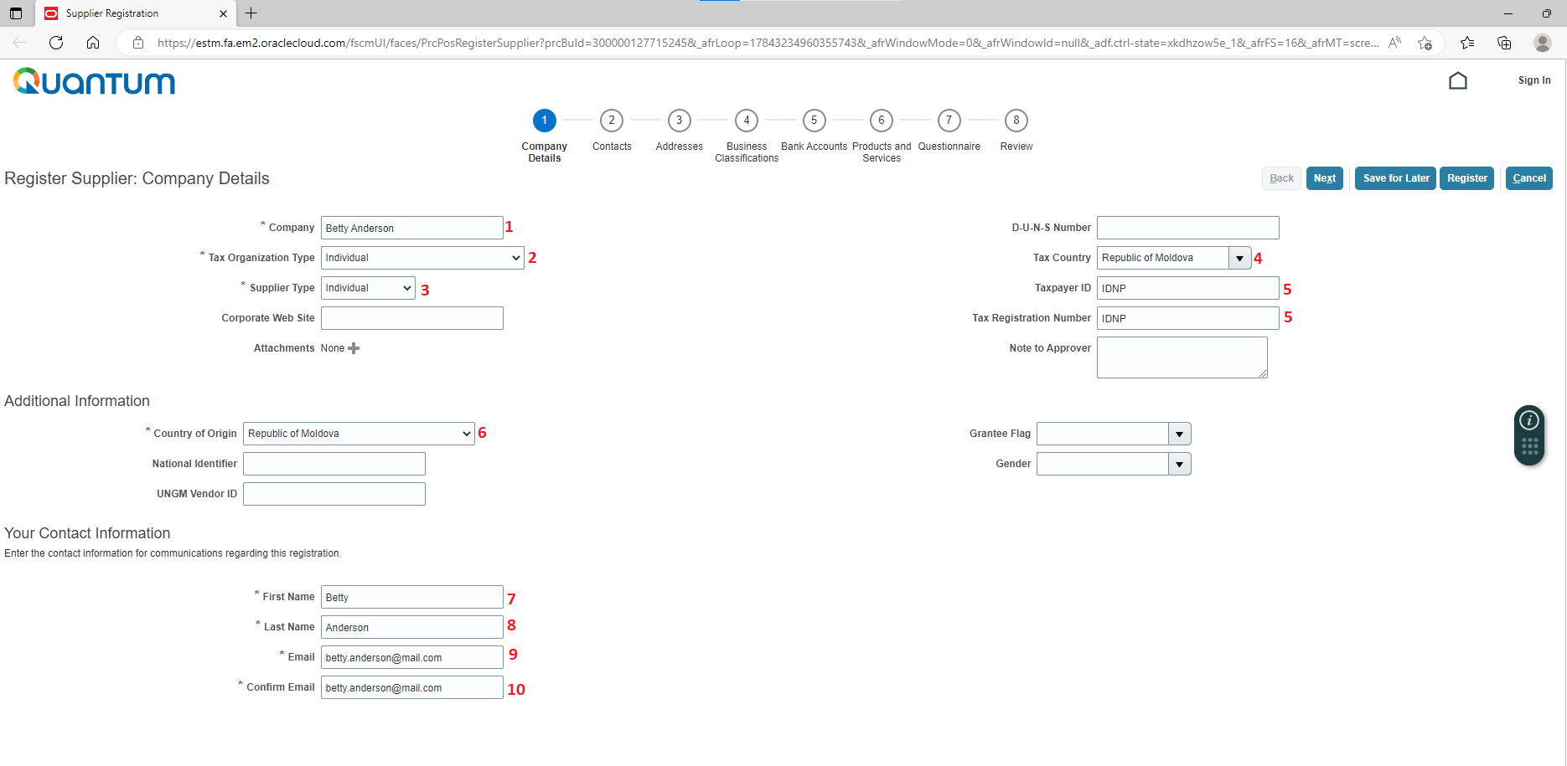
Step 1: Fill in the information below:
1. First and last name
2. “Individual” for Individual Consultant contracts
3. See point 2
4. Select “Republic of Moldova”
5. Enter IDNP from Identification Document
6. Select “Republic of Moldova”
7. First name
8. Last name
9. Email address
10. See point 9

Slide 3
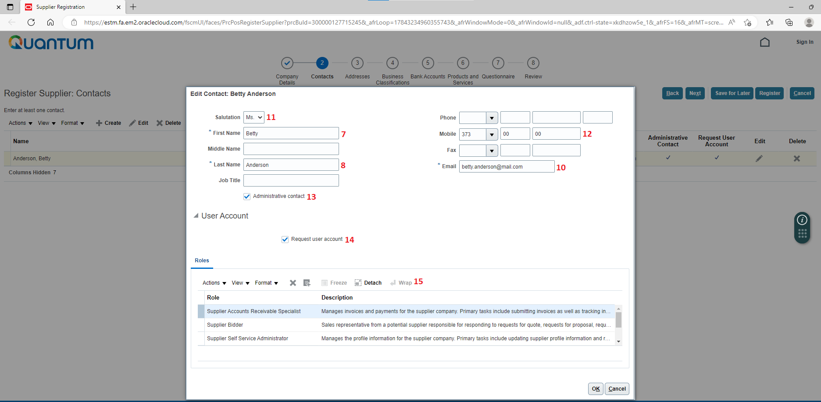
Step 2: Fill in the information below:
11. Select the appropriate value
12. Type in phone number using the format from template
13. Tick-off “Administrative contact” for contact person who will be responsible for profile management
14. Provided the box from point 13 was selected, tick-off “Request user account”
15. Keep all the values listed in the “Roles” section

Slide 4
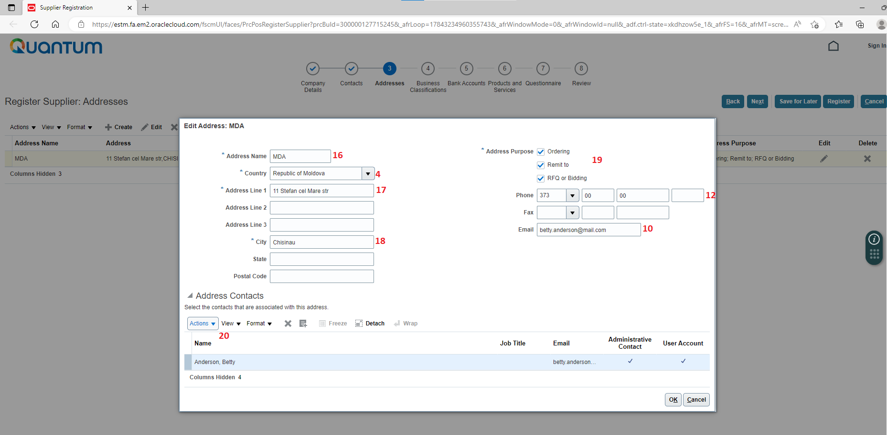
Step 3: Fill in the information below:
16. Type “MDA”
17. Type in legal address using the format from template
18. Type in name of city as stated in legal address
19. Keep all three options selected
20. Click on “Actions” button and select the person listed as administrative contact.
Select and add contact from Step 2

Slide 5
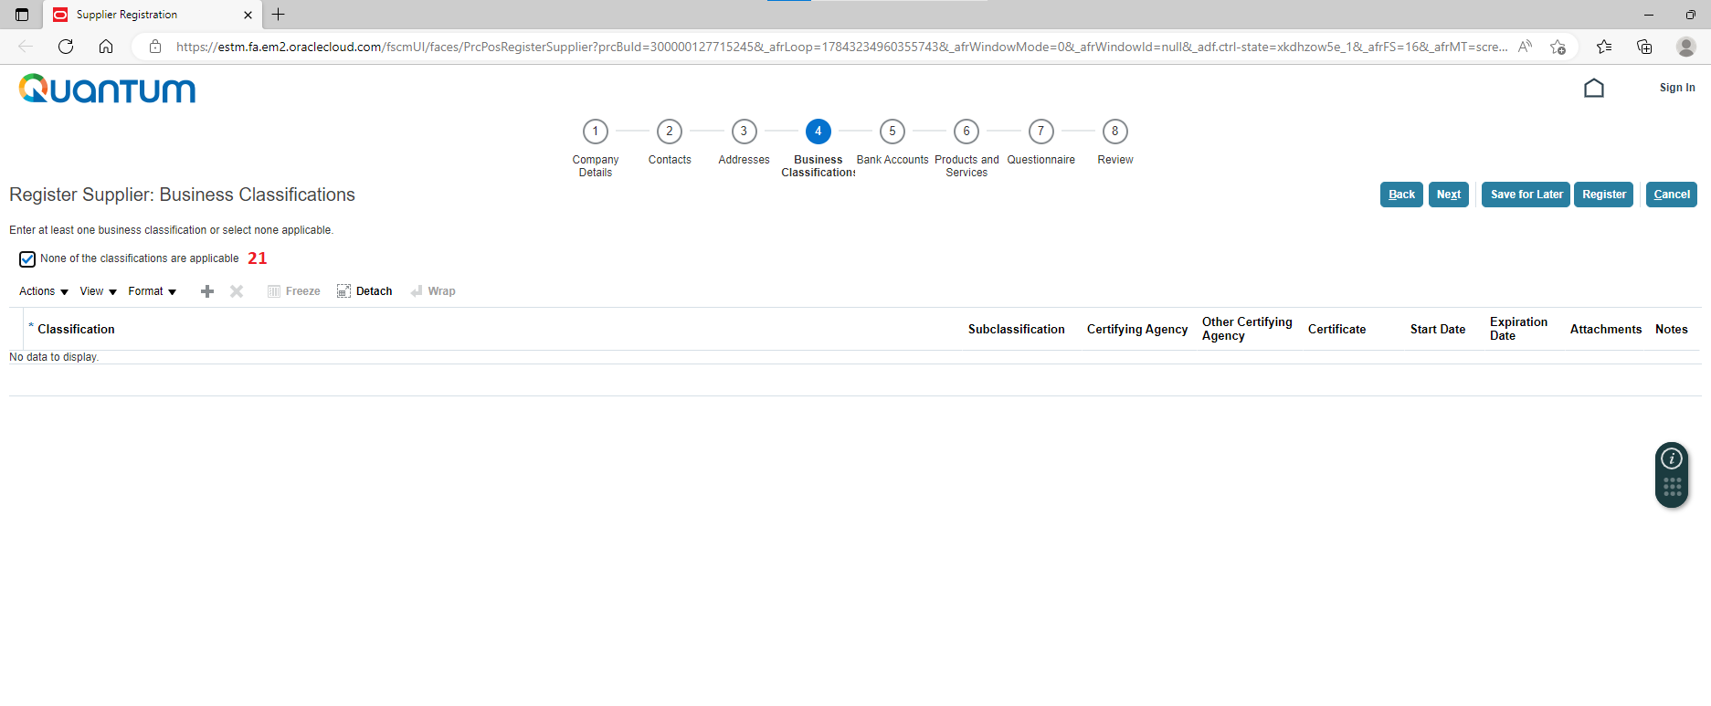
Step 4: Fill in the information below:
21. Tick-off the box

Slide 6
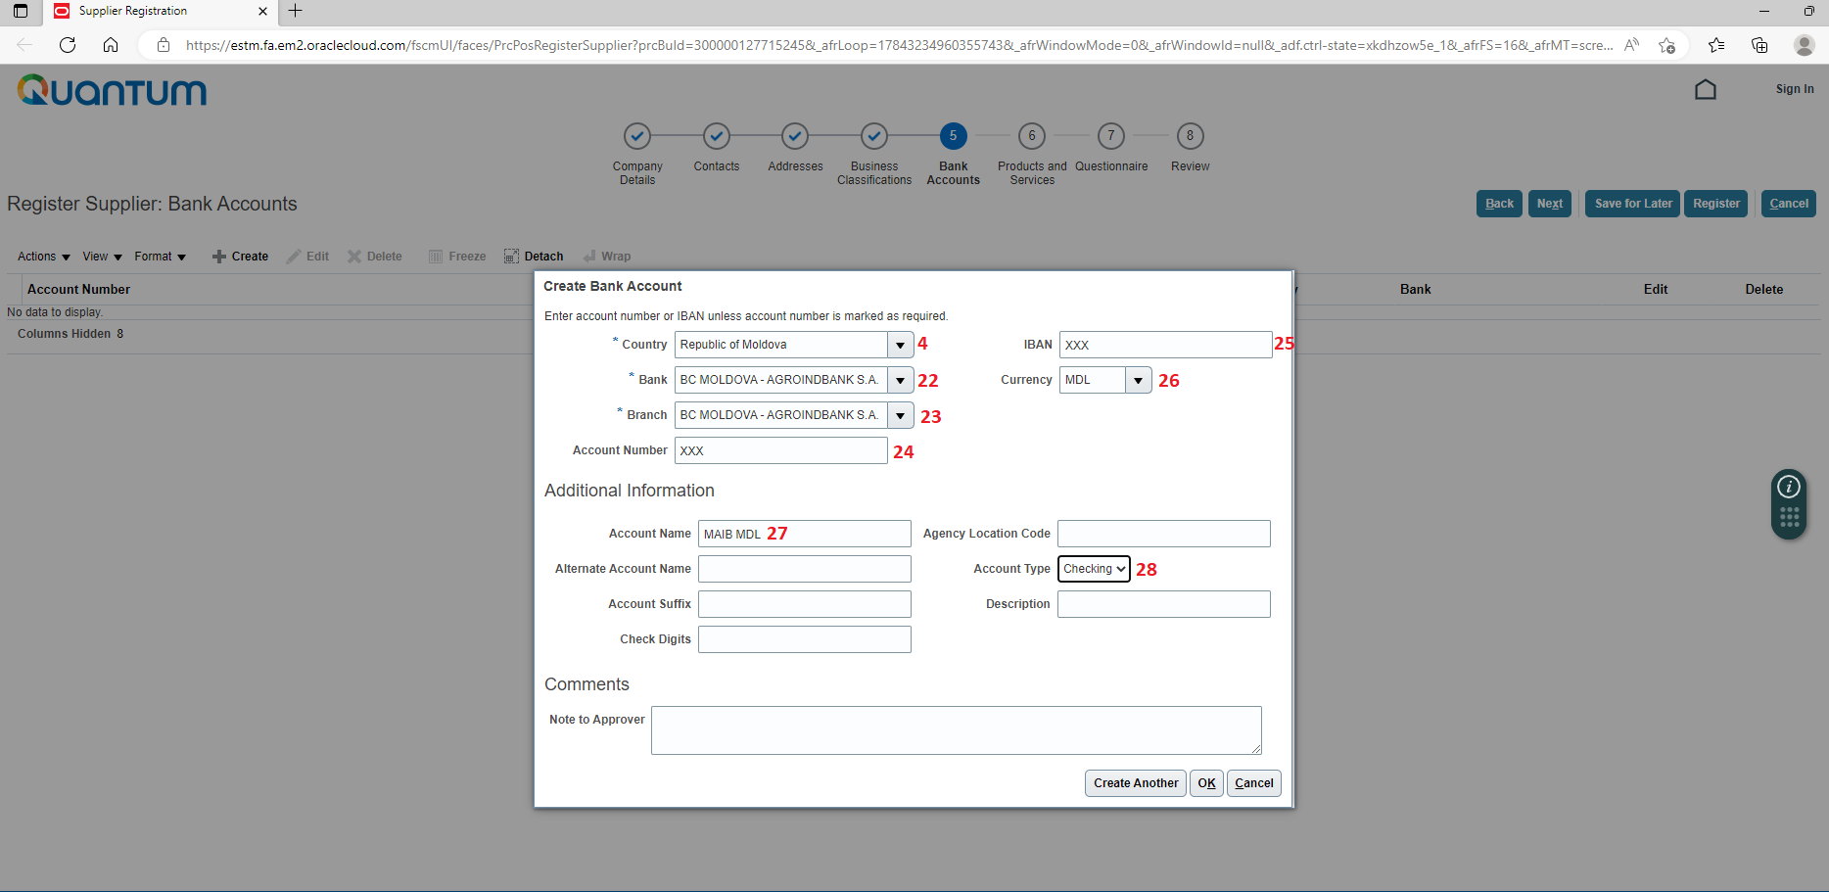
Step 5: Fill in the information below:
22. Select bank name
23. Select bank branch
24. Type in account number
25. Type in IBAN (24 characters)
26. Select currency code
27. Type in account name using the format from template
28. Select “Checking”

Slide 7
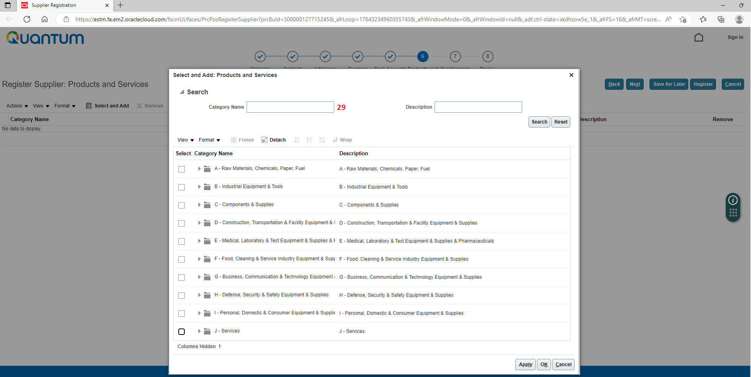
Step 6: Choose “J - Services”

Slide 8
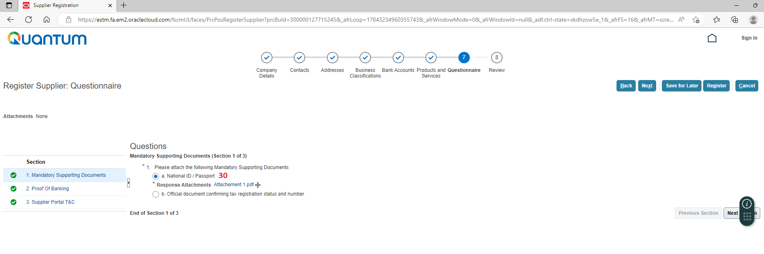
Step 7 (a): Upload National ID/ Passport
Select Next Section
Upload here

Slide 9
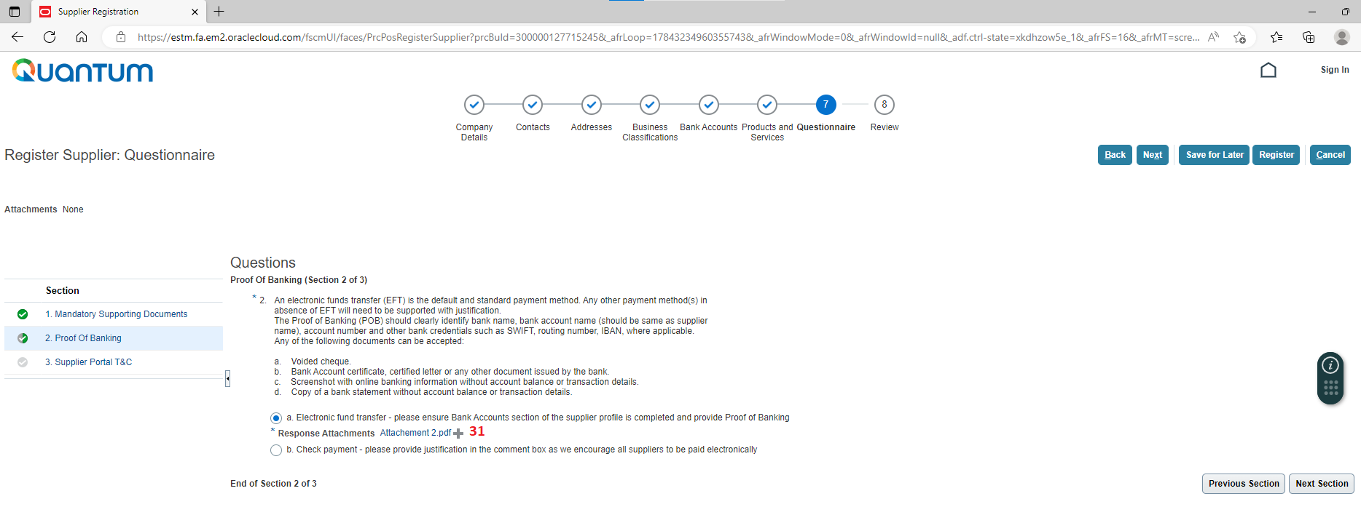
Step 7 (b): Upload Proof of Banking
Select Next Section

Slide 10
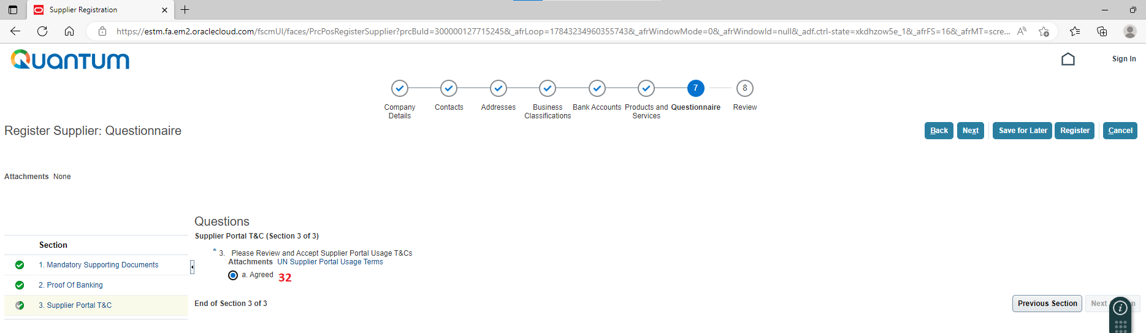
Step 7 (c): Select “Agreed”

Slide 11
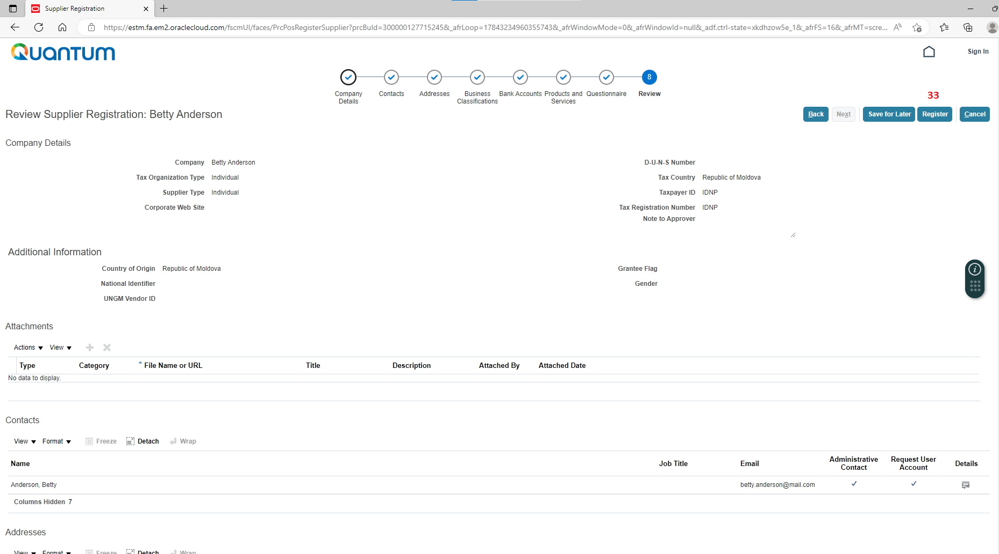
Step 8: Review the submitted information and click Register

