Slide 1
Step-by-step self-registration guide for companies
Self-registration link (Spend Authorized): https://estm.fa.em2.oraclecloud.com/fscmUI/faces/PrcPosRegisterSupplier?prcBuId=300000127715245&busRel=DQXgt7bL7oaiptFEuuXYt0LQHZyjNzWdBQ%3D%3D
Self-registration link (Prospective): https://estm.fa.em2.oraclecloud.com/fscmUI/faces/PrcPosRegisterSupplier?prcBuId=300000127715245

Slide 2
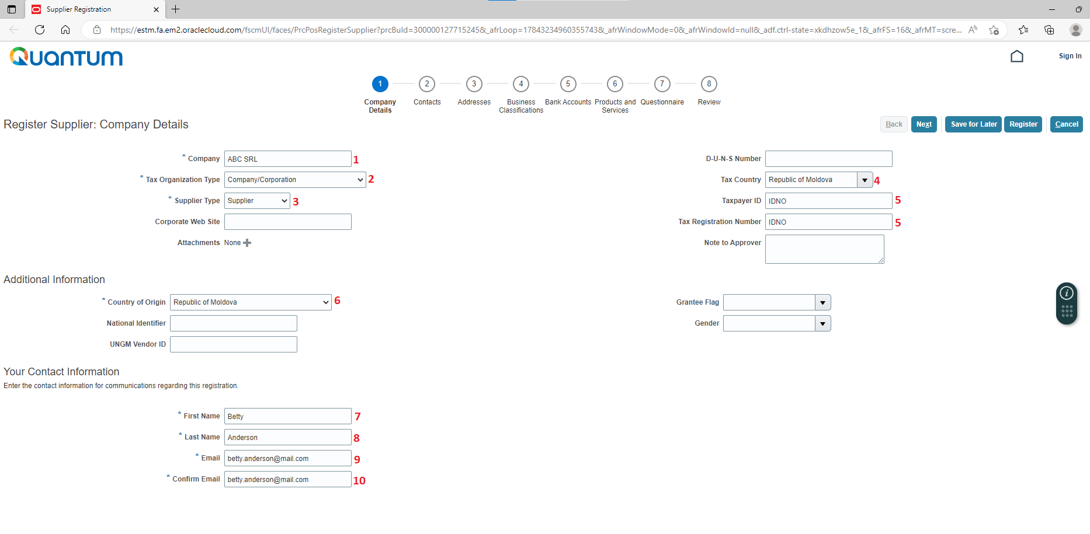
Step 1: Fill in the information below: 1. Company name 2. Company/ Corporation or other 3. Supplier 4. Select “Republic of Moldova” 5. Enter IDNO from Registration Document
6. Select “Republic of Moldova”
7. First name of the company’s representative authorized to sign contracts
8. Last name of the above representative
9. Email address
10. See point 9

Slide 3
Step 2: Fill in the information below: 11. Select the appropriate value 12. Type in phone number using the format from template 13. Tick-off “Administrative contact” for contact person who will be responsible for profile management 14. Provided the box from point 13 was selected, tick-off “Request user account” 15. Keep all the values listed in the “Roles” section

Slide 4
Step 3: Fill in the information below: 16. Type “MDA” 17. Type in legal address using the format from template 18. Type in name of city as stated in legal address 19. Keep all three options selected 20. Click on “Actions” button and select the person listed as administrative contact.
Select and add contact from Step 2

Slide 5
Step 4: Fill in the information below: 21. Tick-off the box

Slide 6
Step 5: Fill in the information below: 22. Select bank name 23. Select bank branch 24. Type in account number 25. Type in IBAN (24 characters) 26. Select currency code 27. Type in account name using the format from template 28. Select “Checking”

Slide 7
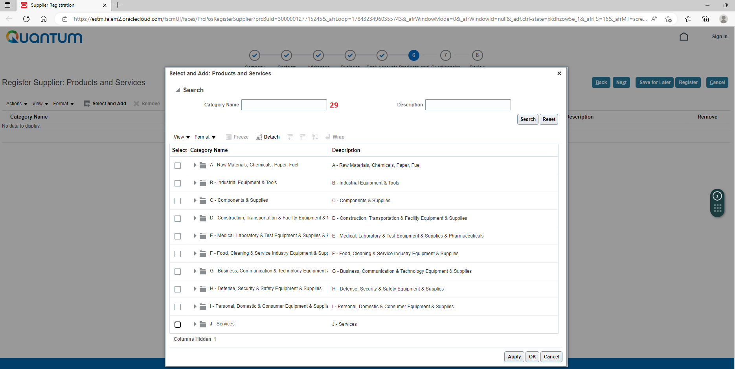
Step 6: Choose category

Slide 8
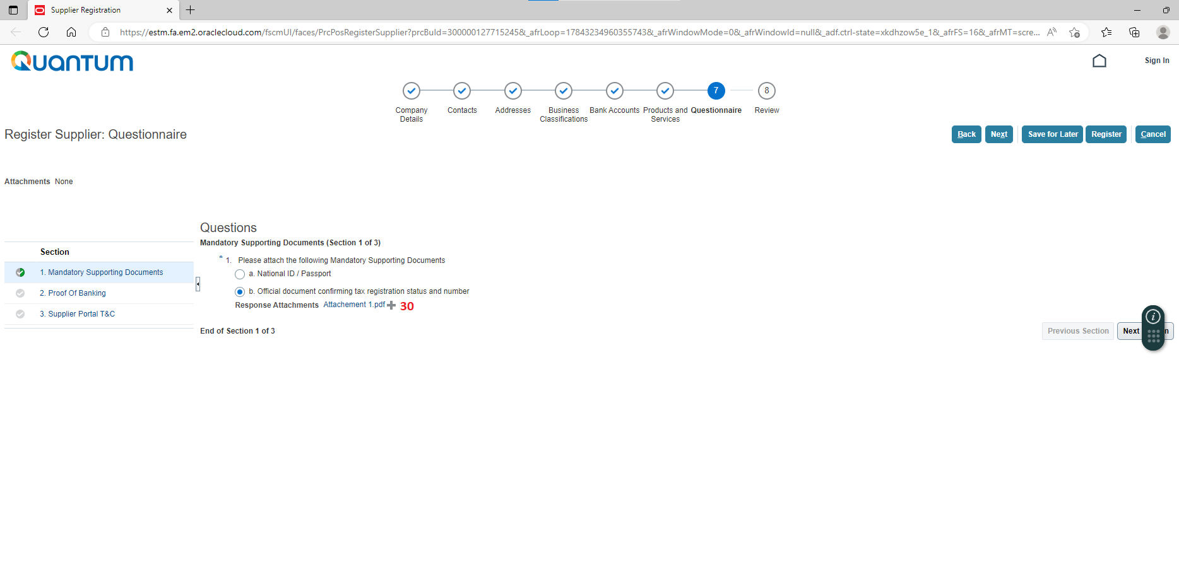
Step 7 (a): Upload Registration Certificate
Select Next Section

Slide 9
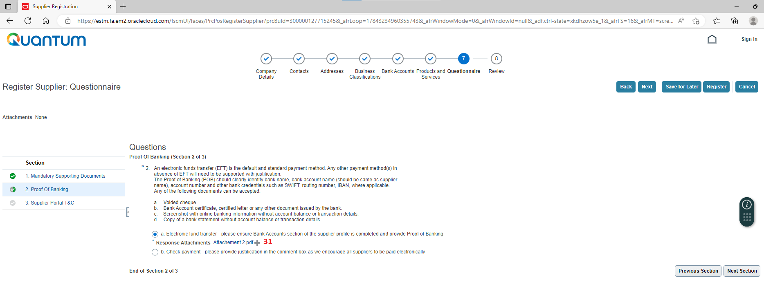
Step 7 (b): Upload Proof of Banking
Select Next Section
Upload here

Slide 10
Step 7 (c): Select “Agreed”

Slide 11
Step 8: Review the submitted information and click Register

Slide 12
Step 9: Wait for email notification to complete registration
Please note that the access link to the Supplier registered profile is sent from Oracle within up to 3 days.
In case you have not received the access link after 3 days since registration, you should address for support to UNDP at the email address: sc.md@undp.org.
In case you encounter errors with registration (e.g. system states Supplier already is registered), you should address for support to UNDP at the email address: sc.md@undp.org.
Computer firewall could block oracle or undp.org extension and Suppliers might not receive the Oracle notifications. Please turn down any firewalls on your computers to ensure receipt of email notification.

